Slide 1
COMPUTER ENGINEERING EDUCATION
PROMPT ENGINEERING: ZERO TO HERO
Master the Art of Talking to AI
FOR
LEVEL
Class 11 Computer Engineering Students
Beginner Friendly, No Prior AI Knowledge Needed
Learn • Practice • Master
Your Journey Starts Here

Slide 2
CONTENTS
What You'll Learn Today
01
02
Introduction
How AI Understands
AI, Prompts & Why it Matters
Instructions & Clear Communication
03
04
Types of Prompts
Good vs Bad Prompts
5 Essential Prompt Styles
Examples & Comparison
05
06
R-O-C-K Technique
Step-by-Step Guide
Role, Objective, Context, Constraints
How to Write Great Prompts

Slide 3


INTRODUCTION
Understanding AI & Prompts
The Building Blocks of Prompt Engineering
1
2
3
What is AI?
What is a Prompt?
Why Learn This?
Computer systems that think, learn, and solve problems, like a smart helper!
Get better answers, save time on homework, and build a future career skill.
These are the instructions, questions, or commands you give to AI.
Examples: ChatGPT, Google Assistant
Key Benefit: Better prompts = Better results!
Examples: "Explain photosynthesis", "Siri, play my favorite playlist", "Write a poem about space"

Slide 4


INTRODUCTION
Prompt Engineering & Its Importance
The art of designing clear, specific instructions to get the best results from AI.
Save Time
Complete homework faster and more efficiently with AI's assistance.
Better Grades
Get accurate answers, deeper explanations, and comprehensive study aids.
Future Career
Develop a highly sought-after skill essential for many tech and innovation jobs.
Think Clearly
Enhance your communication abilities by learning to articulate thoughts precisely.
Key Point: Better prompts = Better AI answers

Slide 5




HOW AI UNDERSTANDS PROMPTS
How AI Understands Your Prompts
Simple rules for getting better answers from AI
How Instructions Guide AI
Real-Life Example
Clear Words = Clear Understanding: Use simple, specific language for AI to grasp your intent easily.
Compare these two prompts:
Details Matter: The more context you provide, the better and more relevant results you'll receive.
❌ BAD PROMPT
Be Specific: Tell the AI exactly what you want it to do or create, leaving no room for ambiguity.
"Write a story"
Why it's bad: Too vague! AI doesn't know what kind, how long, or about what topic.
✓ GOOD PROMPT
"Write a 5-paragraph adventure story about a young astronaut exploring Mars, including vivid descriptions of the red planet's landscape and challenges they face."
Why it's good: Perfect! Clear, specific, with all the details AI needs to deliver a great story.
Clear prompts = Best answers!

Slide 6
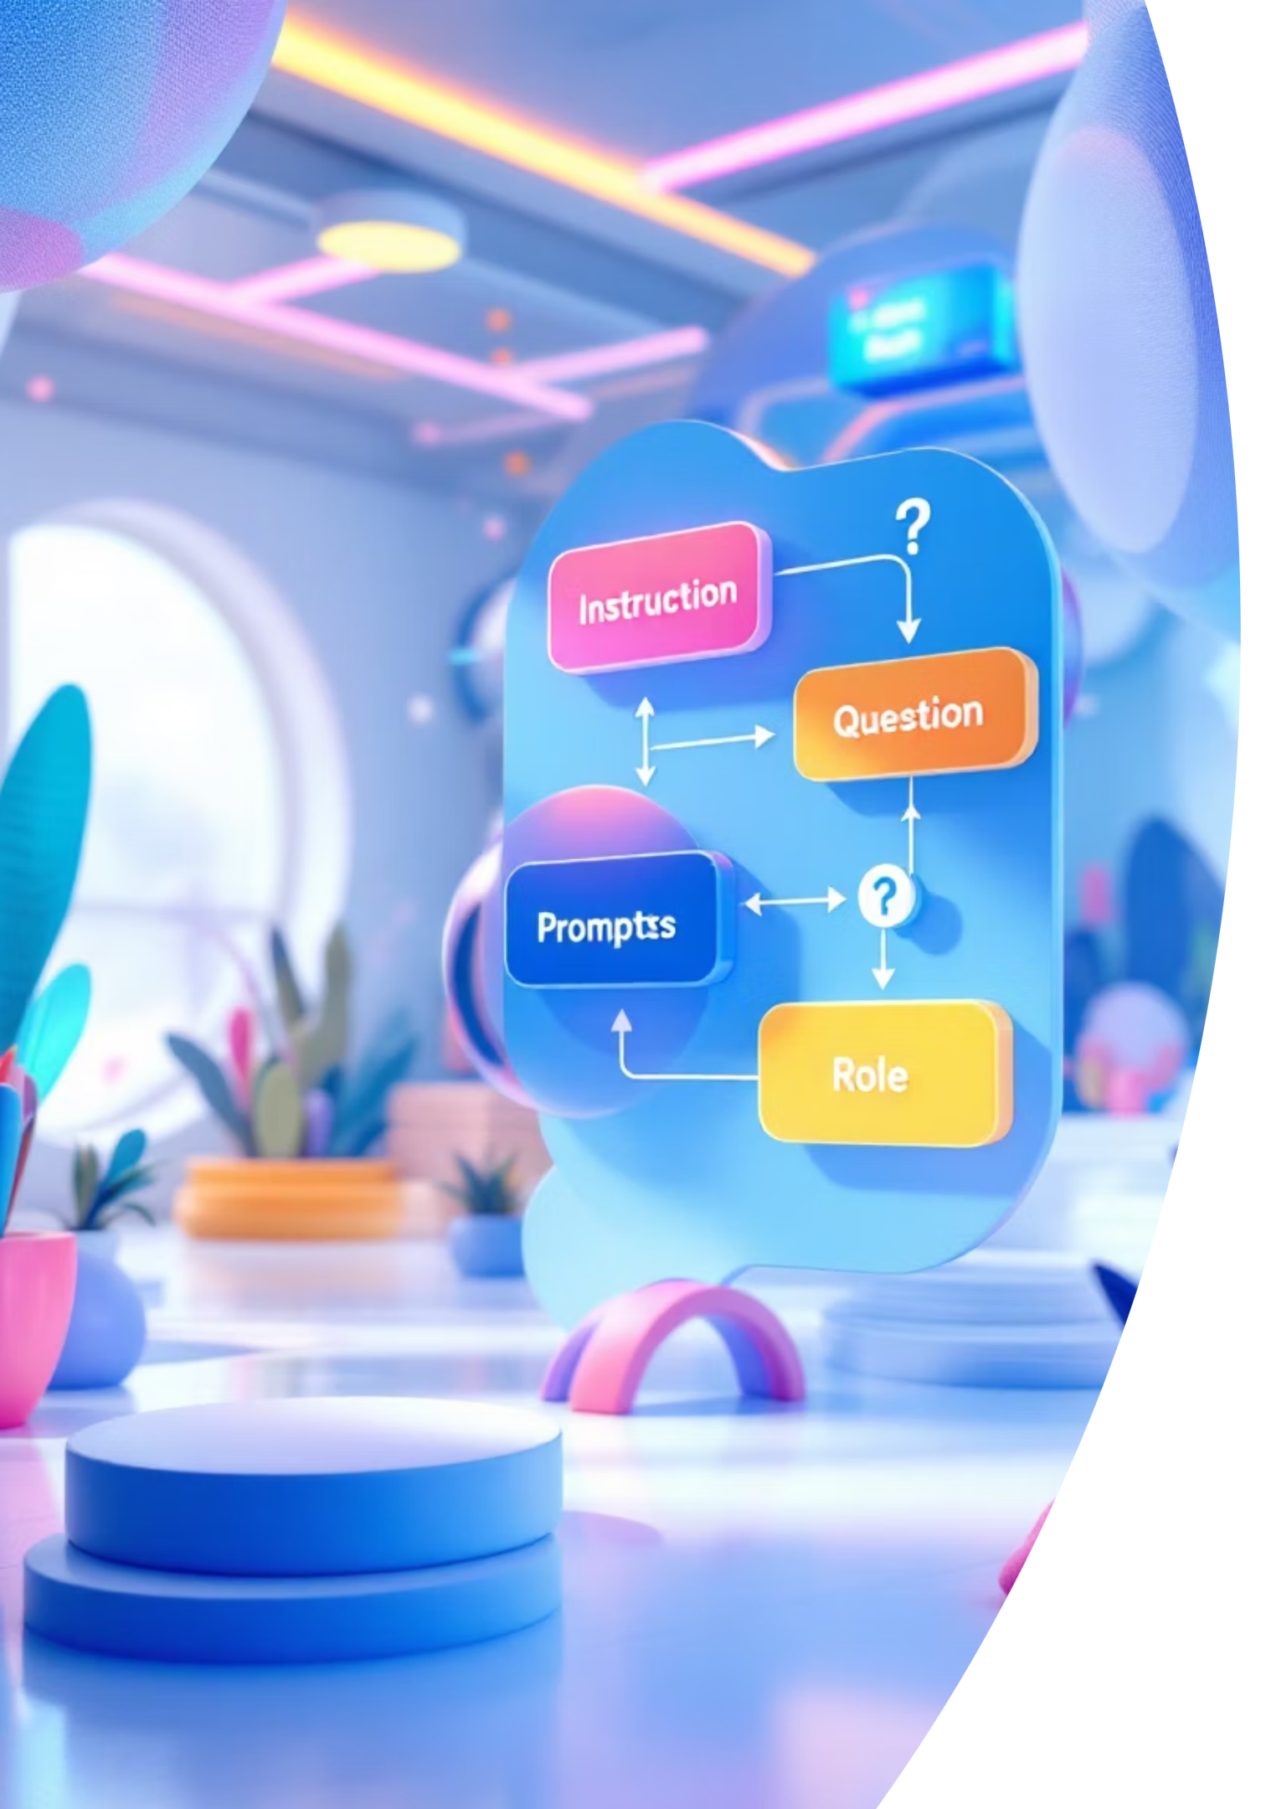
BASIC TYPES OF PROMPTS
Basic Types of Prompts - Part 1
Understanding different ways to talk to AI
Instruction Prompt
Question Prompt
Role-based Prompt
Ask direct questions to get information, explanations, or answers from the AI's knowledge base.
Give clear commands to make AI do something specific, like generating text or solving a problem.
Assign a specific role or personality to AI, which guides its tone, style, and expertise in its response.
EXAMPLE: "What are the main components of a computer?"
EXAMPLE: "Write a paragraph about the importance of computer science."
EXAMPLE: "Act as a math teacher. Explain how to solve quadratic equations."

Slide 7


BASIC TYPES OF PROMPTS
Basic Types of Prompts - Part 2
More ways to communicate effectively with AI
Few-shot Prompt
Context Prompt
Provide AI with a few examples of desired input-output pairs to demonstrate the pattern or style you want it to follow.
Give background information or relevant details to help the AI understand the situation and provide more accurate and tailored responses.
EXAMPLE: "Complete this pattern: 1→One, 2→Two, 3→Three, 4→..."
EXAMPLE: "I'm studying Python. Explain loops with simple examples for a beginner."

Slide 8



PROMPT COMPARISON
Good Prompt vs Bad Prompt
Learn the difference to get better results from AI
❌ BAD PROMPT
❌ BAD PROMPT
"Write something about computers"
"Help me with Python"
✓ GOOD PROMPT
✓ GOOD PROMPT
"I'm a beginner in Python. Explain how to use loops with simple examples. Include 2 code snippets: one for a for-loop and one for a while-loop."
"Write a 3-paragraph article about the importance of learning computer science for high school students, including career opportunities and practical applications."
Why better: States skill level, specific topic, and requests concrete, actionable examples for effective learning.
Why better: Specific length, target audience, and clear topic with examples for a focused response.

Slide 9




THE R-O-C-K TECHNIQUE
The R-O-C-K Technique
A simple formula to write amazing prompts
R
O
Role
Objective
Who should AI act as?
What do you want to achieve?
EXAMPLE: "Act as a teacher"
EXAMPLE: "Explain Python loops"
K
C
Constraints
Context
What rules or limits apply?
What background info is relevant?
EXAMPLE: "Keep it simple, 100 words"
EXAMPLE: "For Class 11 students"
Remember: Use R-O-C-K every time you write a prompt!

Slide 10


R-O-C-K TECHNIQUE - PART 1
R & O: Role & Objective
Building the foundation of your prompt
R
O
Role
Objective
Who should AI act as?
What do you want?
Assign a specific personality, profession, or persona to guide the AI's tone, style, and the depth of its expertise in its response.
Clearly state the main task, question, or the desired output you expect from the AI's response.
EXAMPLE:
EXAMPLE:
"Act as a teacher." This helps AI explain complex topics in simple language for students.
"Explain Python loops." This clearly asks for a specific topic or action.
Quick Tip: Start every prompt with R + O for clearer results!

Slide 11

R-O-C-K TECHNIQUE - PART 2
C & K: Context & Constraints
Adding detail and setting boundaries for your AI prompts
C
K
Context
Constraints
What background info is relevant?
What rules or limits apply?
Provide any necessary background details or information that helps the AI understand the situation, topic, or specific problem you're addressing.
Specify any rules, limitations, or format requirements for the AI's response, such as length, tone, style, or specific output format.
EXAMPLE:
EXAMPLE:
"Keep it simple, explain in 100 words, and use bullet points." This ensures the AI meets specific requirements.
"For Class 11 students, who are learning the basics." This guides the AI on the audience's knowledge level.
Quick Tip: C & K refine your AI's response for precision and clarity!

Slide 12

THE R-O-C-K TECHNIQUE
Step-by-Step: How to Write a Good Prompt
Follow these 5 simple steps to craft amazing prompts
Decide Your Goal
Choose a Role
Clearly define what you want the AI to achieve or produce.
Assign a specific persona or character for the AI to adopt, influencing its tone and response style.
Add Context
Add Constraints
Provide relevant background information or details to help the AI understand the situation better.
Specify any rules, limitations, or format requirements for the AI's output, such as length or style.
Improve and Test
Review the AI's response, make adjustments to your prompt if needed, and try again for optimal results.
Pro Tip: Practice makes perfect! The more prompts you write, the better you'll get at communicating with AI.

Slide 13







USES OF PROMPT ENGINEERING
Uses of Prompt Engineering for Students
How AI can help you learn smarter, not harder
Homework Help
Coding Help
Notes Making
Projects & Presentations
Get step-by-step explanations for difficult problems. Ask for clarification on topics you didn't understand in class.
Debug your code, understand error messages, and learn new programming concepts with real examples.
Summarize long chapters, create quick revision notes, and organize key points effectively.
Brainstorm ideas, create outlines, and get help with content for school projects and presentations.
Learning Faster
Ask for simple explanations, analogies, and real-world examples to grasp complex topics quickly.
Remember: Use prompt engineering ethically. AI is a tool to help you learn, not to do your work for you!

Slide 14
SCOPE OF PROMPT ENGINEERING
Scope of Prompt Engineering
Where it's used today and why it matters for your future
Where It's Used Today
Why It's Important
Technology: AI assistants, code generators, software development.
High Demand Skill: Companies are actively seeking professionals skilled in prompt engineering.
Healthcare: Medical diagnosis, personalized treatment plans, patient care.
Future of Work: AI integration means prompt engineering will be vital across many job roles.
Education: Personalized learning experiences, intelligent tutoring systems.
Competitive Advantage: Distinguish yourself from others by mastering effective AI communication.
Business: Enhanced customer service, data analysis, content creation, marketing.
In Computer Engineering
Build smarter, more responsive AI applications.
Create advanced chatbots and virtual assistants.
Automate complex tasks and workflows efficiently.
Solve challenging computational problems with AI assistance.

Slide 15
FUTURE OF PROMPT ENGINEERING
Future of Prompt Engineering
Exciting opportunities await those who master this skill
AI in Education
AI in Jobs
Personalized learning experiences tailored to individual needs.
AI integration will touch every industry, from tech to healthcare, finance, and marketing.
Instant homework help and detailed explanations.
Prompt engineering will be a core skill for maximizing AI utility in various professional roles.
Interactive tutoring systems for complex subjects.
Increased demand for individuals who can effectively communicate with and direct AI systems.
Smart classrooms integrating AI for administrative tasks and content delivery.
New Careers Emerging
1
AI Trainer
Teaching AI models how to perform tasks and generate accurate responses.
2
Prompt Engineer
Designing, testing, and refining prompts to achieve optimal AI outputs.
3
AI Ethics Specialist
Ensuring AI systems are fair, unbiased, and used responsibly.
4
Conversational Designer
Crafting engaging and intuitive interactions for chatbots and virtual assistants.
5
AI Product Manager
Overseeing the development and deployment of AI-powered products.
6
ML Prompt Optimizer
Specializing in fine-tuning prompts for machine learning models to enhance performance.
Your Future Starts Now
Students who master prompt engineering today will be the leaders of tomorrow. Embrace the AI revolution to stay ahead, innovate, and shape the future. Be an AI pioneer!

Slide 16





FUTURE OF PROMPT ENGINEERING
Key Takeaways: Shaping Your Future with AI
Embrace these insights to thrive in an AI-driven world
Ubiquitous AI Integration
Core Communication Skill
AI will transform every industry, from tech to healthcare, demanding new skill sets.
Prompt engineering is crucial for effectively directing AI and maximizing its utility across roles.
Dynamic Career Paths
Lead the AI Revolution
Exciting new jobs like AI Trainer, Prompt Engineer, and AI Ethics Specialist are rapidly emerging.
Early mastery of prompt engineering positions you as a leader in the evolving AI landscape.
Your future starts now: Be an AI pioneer and shape tomorrow's world!

Slide 17

FUTURE OF PROMPT ENGINEERING
Key Points to Remember
Master these fundamentals to become a prompt engineering expert
Prompts Are Instructions
Use R-O-C-K Formula
Clear, specific commands that guide AI to give you the best answers.
Role, Objective, Context, Constraints – your secret to success.
Clarity is King
Practice Every Day
Better prompts lead to better responses. Be specific and detailed.
Start with simple prompts, then try more complex ones to hone your skills.
Start Practicing Today!
Remember: Even experts started as beginners. Every great prompt engineer was once a student just like you!
Your Journey Begins Here
Zero to Hero

